Slide 1
Client Server Database : Basic concept
Dr. Manjiree Vyawahare

Slide 2
Basic concept
In client server computing, the clients requests a resource and the server provides that resource. A server may serve multiple clients at the same time while a client is in contact with only one server.
The different structures for two tier and three tier are given as follows −
Two - Tier Client/Server Structure
The two tier architecture primarily has two parts, a client tier and a server tier.The client tier sends a request to the server tier and the server tier responds with the desired information.
An example of a two tier client/server structure is a web server. It returns the required web pages to the clients that requested them.
An illustration of the two-tier client/server structure is as follows −

Slide 3
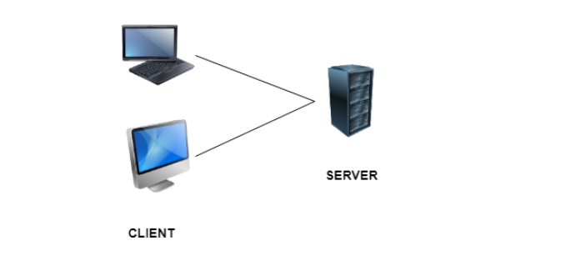

Slide 4
Advantages of Two - Tier Client/Server Structure
Some of the advantages of the two-tier client/server structure are −
This structure is quite easy to maintain and modify.
The communication between the client and server in the form of request response messages is quite fast.
Disadvantages of Two - Tier Client/Server Structure
A major disadvantage of the two-tier client/server structure is −
If the client nodes are increased beyond capacity in the structure, then the server is not able to handle the request overflow and performance of the system degrades.

Slide 5
Three - Tier Client/Server Structure
The three tier architecture has three layers namely client, application and data layer. The client layer is the one that requests the information. In this case it could be the GUI, web interface etc. The application layer acts as an interface between the client and data layer. It helps in communication and also provides security. The data layer is the one that actually contains the required data.
An illustration of the three-tier client/server structure is as follows −

Slide 6
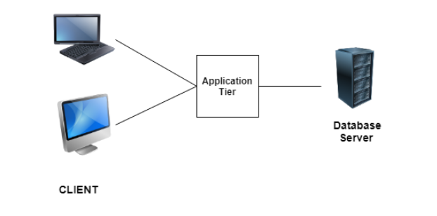

Slide 7
Advantages of Three - Tier Client/Server Structure
Some of the advantages of the three-tier client/server structure are −
The three tier structure provides much better service and fast performance.
The structure can be scaled according to requirements without any problem.
Data security is much improved in the three tier structure.
Disadvantages of Three - Tier Client/Server Structure
A major disadvantage of the three-tier client/server structure is −
Three - tier client/server structure is quite complex due to advanced features.

Slide 8
Basic Client/Server Architectures
The client/server architecture was developed to deal with computing environments in which a large number of PCs, workstations, file servers, printers, data base servers, Web servers, e-mail servers, and other software and equipment are connected via a network.
The idea is to define specialized servers with specific functionalities.
For example, it is possible to connect a number of PCs or small workstations as clients to a file server that maintains the files of the client machines.
Another machine can be designated as a printer server by being connected to various printers; all print requests by the clients are forwarded to this machine.
Web servers or e-mail servers also fall into the specialized server category. The resources provided by specialized servers can be accessed by many client machines.
Notes:
Ebook pdf

Slide 9
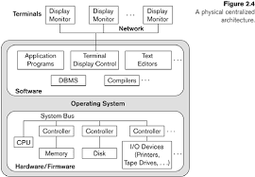
Figure 2.4 A physical centralized architecture.

Slide 10
The client machines provide the user with the appropriate interfaces to utilize these servers, as well as with local processing power to run local applications.
This concept can be carried over to other software packages, with specialized programs—such as a CAD (computer-aided design) package—being stored on specific server machines and being made accessible to multiple clients.
Figure 2.5 illustrates client/server architecture at the logical level; Figure 2.6 is a simplified diagram that shows the physical architecture.
Some machines would be client sites only (for example, diskless workstations or workstations/PCs with disks that have only client software installed)

Slide 11
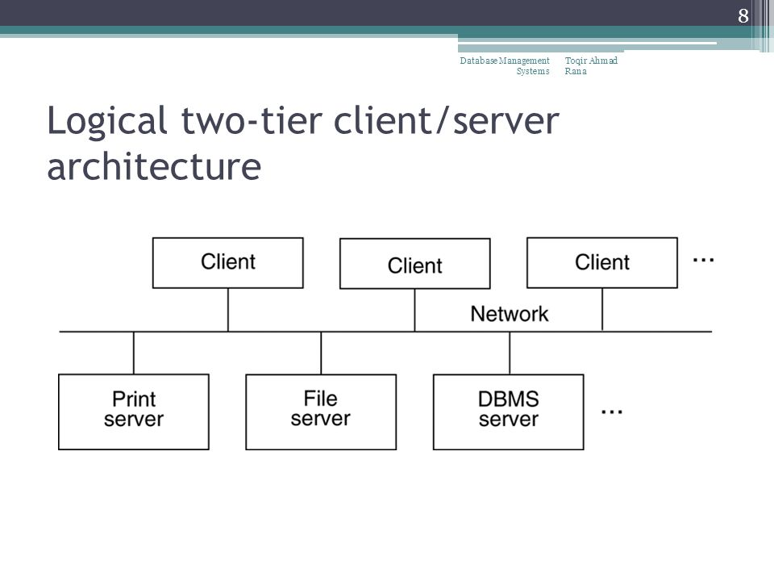
Figure 2.5 Logical two-tier client/server architecture.

Slide 12
Other machines would be dedicated servers, and others would have both client and server functionality.
The concept of client/server architecture assumes an underlying framework that consists of many PCs and workstations as well as a smaller number of mainframe machines, connected via LANs and other types of computer networks.
A client in this framework is typically a user machine that provides user interface capabilities and local processing.
When a client requires access to additional functionality— such as database access—that does not exist at that machine, it connects to a server that provides the needed functionality.
A server is a system containing both hardware and software that can provide services to the client machines, such as file access, printing, archiving, or database access.
In general, some machines install only client software, others only server software, and still others may include both client and server software, as illustrated in Figure 2.6.
However, it is more common that client and server software usually run on separate machines.
Two main types of basic DBMS architectures were created on this underlying client/server framework: two-tier and three-tier.

Slide 13
Figure 2.6 Physical two-tier client/server architecture.
Diskless Client
Client with Disk
Server
Server
server
server
Client
Client
Client
Site 1
Site 3
Site 2
Site…n
Communication Network

Slide 14
Two-Tier Client/Server Architectures for DBMSs
In relational database management systems (RDBMSs), many of which started as centralized systems,
the system components that were first moved to the client side were the user interface and application programs. Because SQL provided a standard language for RDBMSs, this created a logical dividing point

Slide 15
For example, the server level may include the part of the DBMS software responsible for handling data storage on disk pages, local concurrency control and recovery, buffering and caching of disk pages, and other such functions. Meanwhile, the client level may handle the user interface; data dictionary functions; DBMS interactions with programming language compilers; global query optimization, concurrency control, and recovery across multiple servers; structuring of complex objects from the data in the buffers; and other such functions. In this approach, the client/server interaction is more tightly coupled and is done internally by the DBMS modules—some of which reside on the client and some on the server—rather than by the users/programmers. The exact division of functionality can vary from system to system. In such a client/server architecture, the server has been called a data server because it provides data in disk pages to the client. This data can then be structured into objects for the client programs by the client-side DBMS software

Slide 16
The architectures described here are called two-tier architectures because the software components are distributed over two systems: client and server. The advantages of this architecture are its simplicity and seamless compatibility with existing systems. The emergence of the Web changed the roles of clients and servers, leading to the three-tier architecture

Slide 17
Three-Tier and n-Tier Architectures for Web Applications
Many Web applications use an architecture called the three-tier architecture, which adds an intermediate layer between the client and the database server, as illustrated in Figure 2.7(a) between client and server.
Hence, the query and transaction functionality related to SQL processing remained on the server side.
In such an architecture, the server is often called a query server or transaction server because it provides these two functionalities
In an RDBMS, the server is also often called an SQL server.
The user interface programs and application programs can run on the client side.
When DBMS access is required, the program establishes a connection to the DBMS (which is on the server side); once the connection is created, the client program can communicate with the DBMS.

Slide 18
A standard called Open Database Connectivity (ODBC) provides an application programming interface (API), which allows client-side programs to call the DBMS, as long as both client and server machines have the necessary software installed.
Most DBMS vendors provide ODBC drivers for their systems.
A client program can actually connect to several RDBMSs and send query and transaction requests using the ODBC API, which are then processed at the server sites.
Any query results are sent back to the client program, which can process and display the results as needed
A related standard for the Java programming language, called JDBC, has also been defined.
This allows Java client programs to access one or more DBMSs through a standard interface.
The different approach to two-tier client/server architecture was taken by some object-oriented DBMSs, where the software modules of the DBMS were divided between client and server in a more integrated way.

Slide 19
Figure 2.7 Logical three-tier client/server architecture, with a couple of commonly used nomenclatures.
Client
Application Server or Web Server
Database Server
GUI, Web Interface
Presentation Layer
Application Programs, Web Pages
Business Logic Layer
Database Management System
Database Services Layer
(a)
(b)

Slide 20
This intermediate layer or middle tier is called the application server or the Web server, depending on the application.
This server plays an intermediary role by running application programs and storing business rules (procedures or constraints) that are used to access data from the database server.
It can also improve database security by checking a client’s credentials before forwarding a request to the database server.
Clients contain GUI interfaces and some additional application-specific business rules.
The intermediate server accepts requests from the client, processes the request and sends database queries and commands to the database server, and then acts as a conduit for passing (partially) processed data from the database server to the clients, where it may be processed further and filtered to be presented to users in GUI format.
Thus, the user interface, application rules, and data access act as the three tiers. Figure 2.7(b) shows another architecture used by database and other application package vendors.
The presentation layer displays information to the user and allows data entry.
The business logic layer handles intermediate rules and constraints before data is passed up to the user or down to the DBMS.
The bottom layer includes all data management services.
The middle layer can also act as a Web server, which retrieves query results from the database server and formats them into dynamic Web pages that are viewed by the Web browser at the client side

Slide 21
Other architectures have also been proposed.
It is possible to divide the layers between the user and the stored data further into finer components, thereby giving rise to n-tier architectures, where n may be four or five tiers.
Typically, the business logic layer is divided into multiple layers.
Besides distributing programming and data throughout a network, n-tier applications afford the advantage that any one tier can run on an appropriate processor or operating system platform and can be handled independently.
Vendors of ERP (enterprise resource planning) and CRM (customer relationship management) packages often use a middleware layer, which accounts for the front-end modules (clients) communicating with a number of back-end databases (servers).

Slide 22
Advances in encryption and decryption technology make it safer to transfer sensitive data from server to client in encrypted form, where it will be decrypted.
The latter can be done by the hardware or by advanced software.
This technology gives higher levels of data security, but the network security issues remain a major concern.
Various technologies for data compression also help to transfer large amounts of data from servers to clients over wired and wireless networks.

Slide 23
Evluation of dbms system till now
Several criteria are normally used to classify DBMSs. The first is the data model on which the DBMS is based. The main data model used in many current commercial DBMSs is the relational data model. The object data model has been implemented in some commercial systems but has not had widespread use. Many legacy applications still run on database systems based on the hierarchical and network data models. Examples of hierarchical DBMSs include IMS (IBM) and some other systems like System 2K (SAS Inc.) and TDMS. IMS is still used at governmental and industrial installations, including hospitals and banks, although many of its users have converted to relational systems. The network data model was used by many vendors and the resulting products like IDMS (Cullinet—now Computer Associates), DMS 1100 (Univac—now Unisys), IMAGE (Hewlett-Packard), VAXDBMS (Digital—then Compaq and now HP), and SUPRA (Cincom) still have a following and their user groups have their own active organizations. If we add IBM’s popular VSAM file system to these, we can easily say that a reasonable percentage of worldwide-computerized data is still in these so-called legacy database systems. The relational DBMSs are evolving continuously, and, in particular, have been incorporating many of the concepts that were developed in object databases. This has led to a new class of DBMSs called object-relational DBMSs. We can categorize DBMSs based on the data model: relational, object, object-relational, hierarchical, network, and other. More recently, some experimental DBMSs are based on the XML (eXtended Markup Language) model, which is a tree-structured (hierarchical) data model. These have been called native XML DBMSs. Several commercial relational DBMSs have added XML interfaces and storage to their products. The second criterion used to classify DBMSs is the number of users supported by the system. Single-user systems support only one user at a time and are mostly used with PCs. Multiuser systems, which include the majority of DBMSs, support concurrent multiple users. The third criterion is the number of sites over which the database is distributed. A DBMS is centralized if the data is stored at a single computer site. A centralized DBMS can support multiple users, but the DBMS and the database reside totally at a single computer site. A distributed DBMS (DDBMS) can have the actual database and DBMS software distributed over many sites, connected by a computer network. Homogeneous DDBMSs use the same DBMS software at all the sites, whereas

